Slide 1
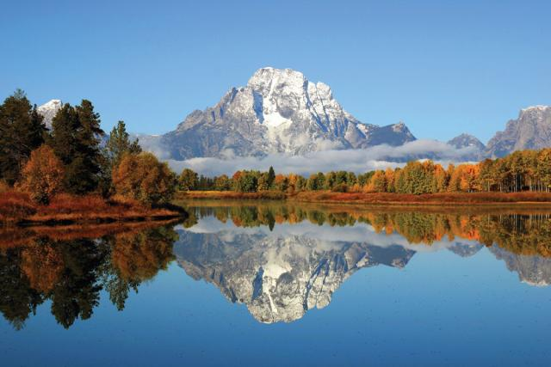
Philippians 3:10-11
Knowing Christ
Dan Bridges Amman International Church, Jordan (AmmanChurch.org) Uploaded by Dr. Rick Griffith • Jordan Evangelical Theological Seminary Files in many languages for free download at BibleStudyDownloads.org

Slide 2
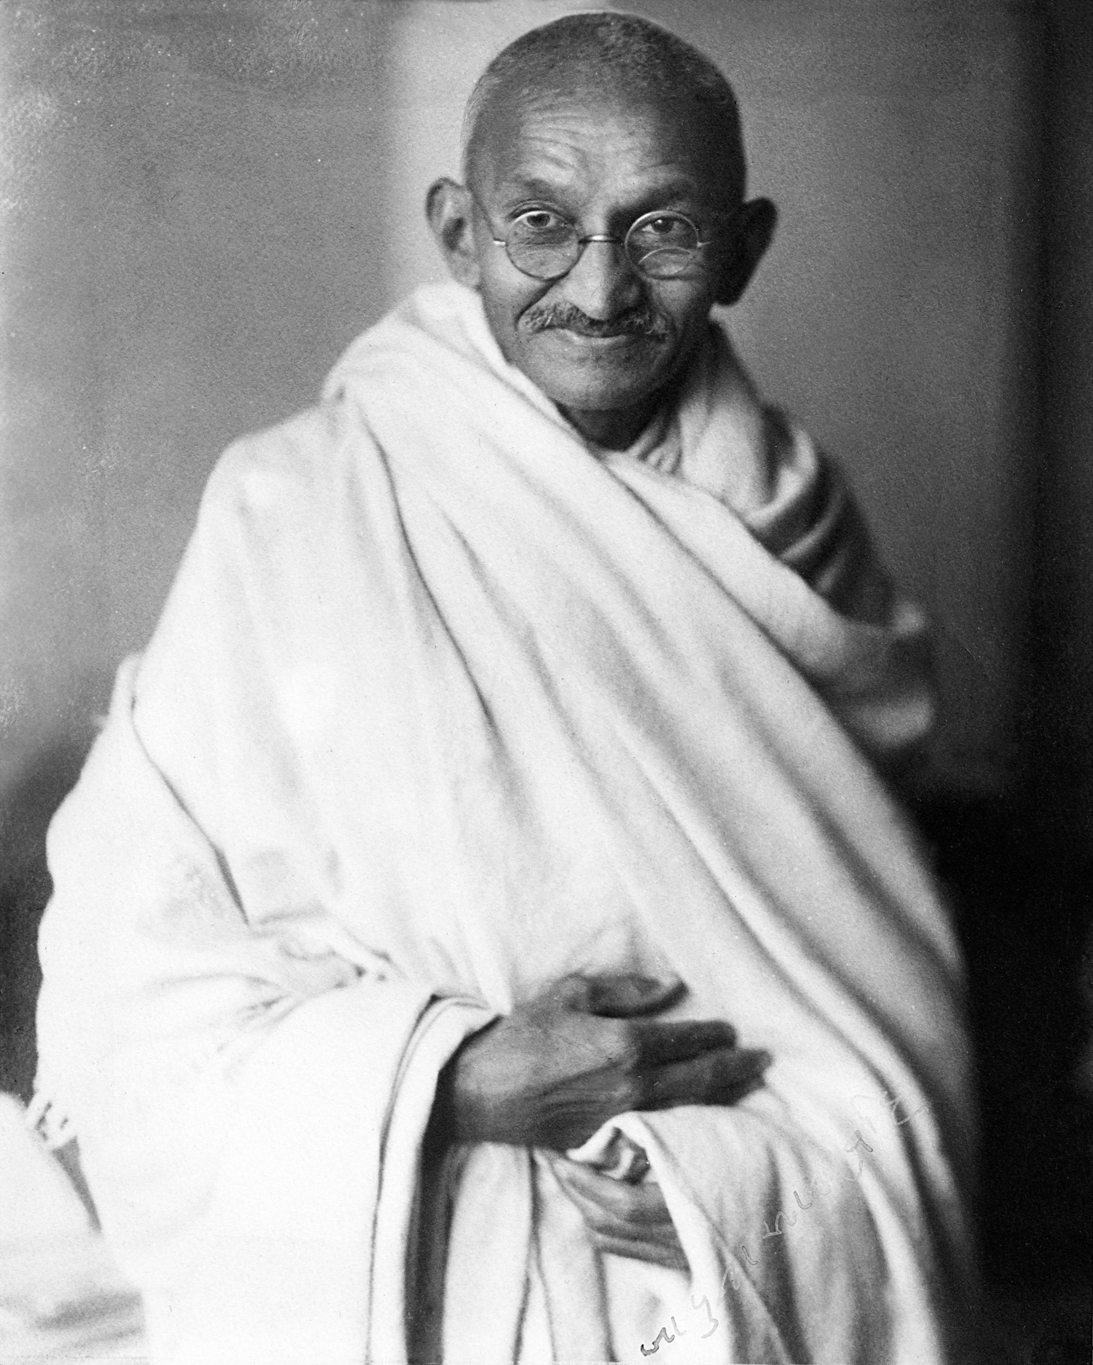
Heart Bond
Love
Commitment
Trust
Affection
Researcher:
I “know” Gandhi!
Mother:
I “know” my child!

Slide 3
What does it mean to
“Know God”?

Slide 4
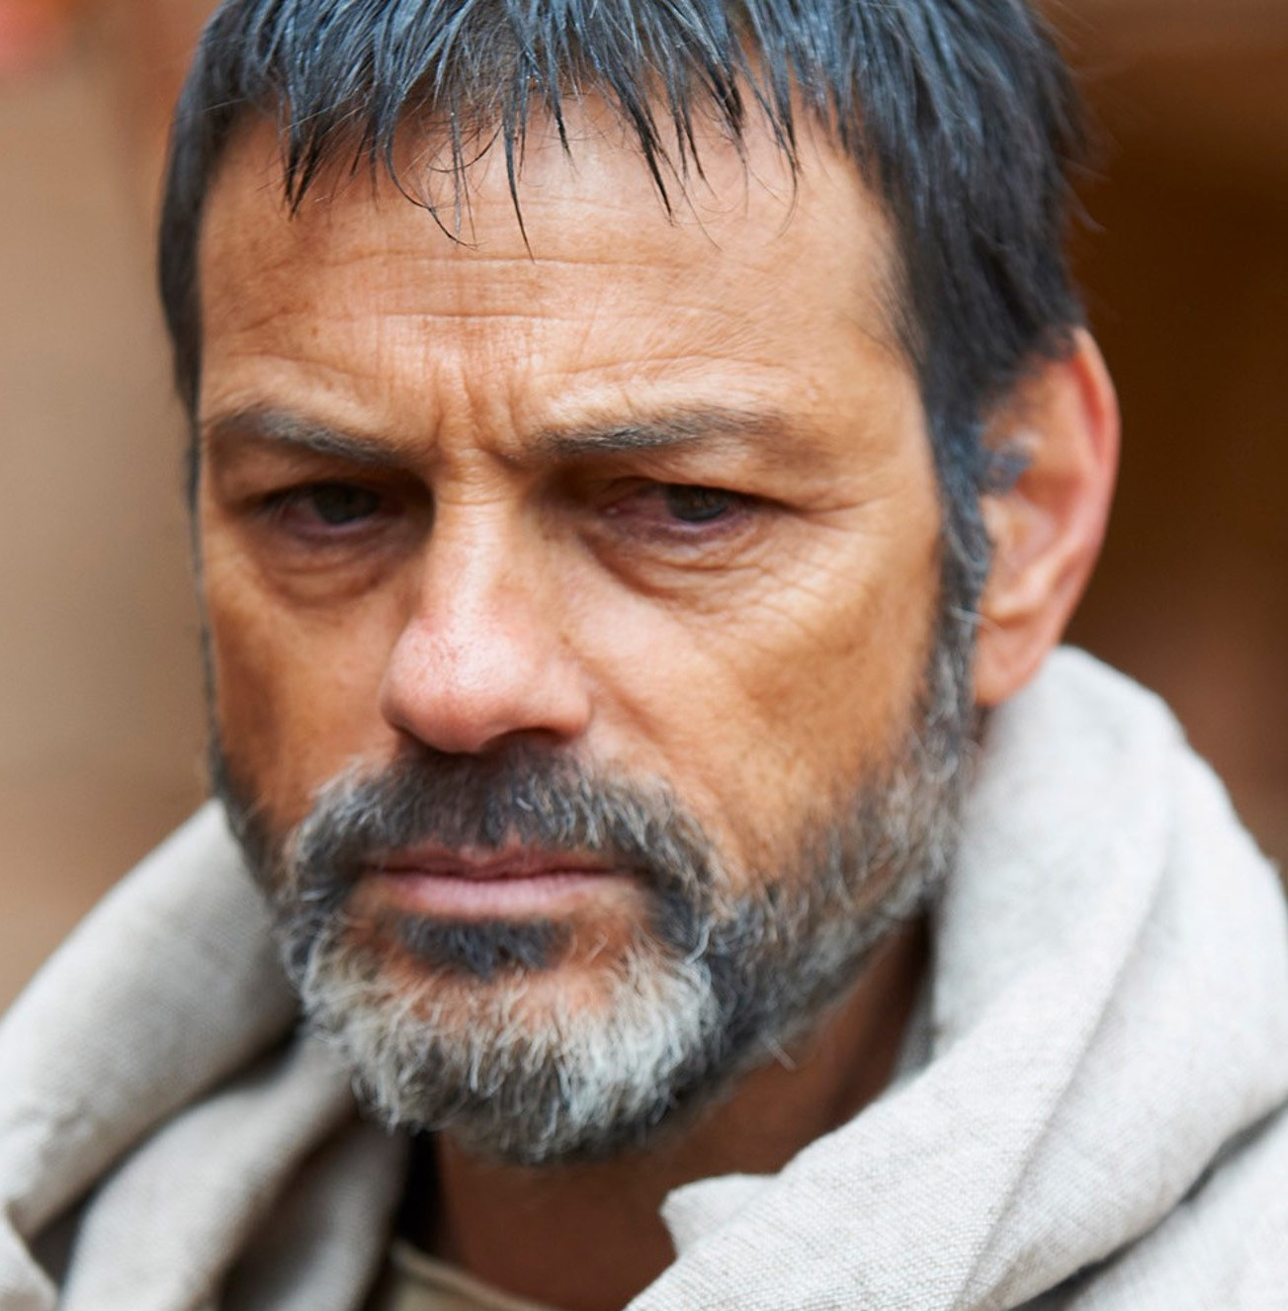
Apostle Paul
Jew of Jews
Highly trained Pharisee
Blameless in keeping the Jewish Law
Did he “Know God”?

Slide 5
Profit Sheet:
√
√
√
√
√
√
√
Inherited fleshly advantages:
circumcised on the eighth day
of the people of Israel
of the tribe of Benjamin
a Hebrew of Hebrews
Attained fleshly advantages:
as to the law, a Pharisee
as to zeal, a persecutor of the church
as to righteousness under the law, blameless

Slide 6
But whatever gain I had, I counted as loss for the sake of Christ.
Philippians 3:7

Slide 7
⁸ Indeed, I count everything as loss because of the surpassing worth of knowing Christ Jesus my Lord. For his sake I have suffered the loss of all things and count them as rubbish, in order that I may gain Christ ⁹ and be found in him, not having a righteousness of my own that comes from the law, but that which comes through faith in Christ, the righteousness from God that depends on faith –
Philippians 3:8-9

Slide 8
¹⁰ that I may know him and the power of his resurrection, and may share his sufferings, becoming like him in his death, ¹¹ that by any means possible I may attain the resurrection from the dead.
Philippians 3:10-11

Slide 9
⁸ Indeed, I count everything as loss because of the surpassing worth of knowing Christ Jesus my Lord... ¹⁰ that I may know him and the power of his resurrection, and may share his sufferings, becoming like him in his death, ¹¹ that by any means possible I may attain the resurrection from the dead.
Philippians 3:8, 10-11

Slide 10
What does it mean to Know Christ?
The nature of this knowledge
The path to this knowledge
The fruit of this knowledge
Notes:
It is in knowing Jesus that we can know God!

Slide 11
1. The Nature of this Knowledge
⁹ and be found in him… [having] the righteousness from God that depends on faith – ¹⁰ that I may know him and the power of his resurrection, and may share his sufferings, becoming like him in his death, ¹¹ that by any means possible I may attain the resurrection from the dead.
Philippians 3:9-11

Slide 12
1. The Nature of this Knowledge
We have to be righteous to have it
(The righteousness God gives us through Christ gives us access to God – and therefore to a knowledge of God.)
We can’t have it as unbelievers
(This was a knowledge that Paul did not have before – in spite of his extensive training in the scriptures!)

Slide 13
1. The Nature of this Knowledge
We are dependent on God to give it to us
(As in any relationship, we are dependent on the other one revealing their heart to us.)
I do not cease to give thanks for you, remembering you in my prayers, that the God of our Lord Jesus Christ, the Father of glory, may give you the Spirit of wisdom and of revelation in the knowledge of him…
Ephesians 1:16-17

Slide 14
1. The Nature of this Knowledge
It is intimate and personal – a relationship
Word “know” is the same Greek word used to describe an intimate sexual relationship
In vs. 8, Paul says, “Christ Jesus my Lord” instead of, “The Lord Jesus Christ”.

Slide 15
1. The Nature of this Knowledge
It is transformational
I run in the path of your commands, for you have set my heart free.
Psalm 119:32

Slide 16
1. The Nature of this Knowledge
It is not satisfied – desires more relationship
As a deer pants for flowing streams,
so pants my soul for you, O God.
My soul thirsts for God,
for the living God.
When shall I come and appear before God?
Psalm 42:1-2

Slide 17
1. The Nature of this Knowledge
We have to be righteous to have it
We can’t have it as unbelievers
We are dependent on God to give it to us
It is intimate and personal – a relationship
It is transformational
It is not satisfied – desires more relationship

Slide 18
The Surpassing Greatness of Knowing Christ Jesus my Lord…
The nature of this knowledge
The path to this knowledge
The fruit of this knowledge
Notes:
It is in knowing Jesus that we can know God!

Slide 19
2. The Path to this Knowledge
¹⁰ that I may know him and the power of his resurrection, and may share his sufferings, becoming like him in his death, ¹¹ that by any means possible I may attain the resurrection from the dead.
Philippians 3:10-11

Slide 20
2. The Path to this Knowledge
Two Parts to this Path:
Experiencing his power in our lives
Sharing with him in his sufferings
Notes:
These are not he only paths – they are just the only ones Paul addresses here.

Slide 21
To Know the Power of His Resurrection
Power – Greek dunamis
Miraculous power; achieving power; it will accomplish

Slide 22
To Know the Power of His Resurrection
¹⁷ [I pray] that the God of our Lord Jesus Christ, the Father of glory, may give you the Spirit of wisdom and of revelation in the knowledge of him, ¹⁸ having the eyes of your hearts enlightened, that you may know … what is the immeasurable greatness of his power toward us who believe, according to the working of his great might ²⁰ that he worked in Christ when he raised him from the dead…
Ephesians 1:17-20
This is a miraculous power from God that is available to us! Why?

Slide 23
To Know the Power of His Resurrection
Romans 1:16 The gospel is the power of God for salvation…
The Power to change the Human Heart!
Notes:
The gospel is the power of God to change hearts and lives!

Slide 24
To Know the Power of His Resurrection
We were buried therefore with him by baptism into death, in order that, just as Christ was raised from the dead by the glory of the Father, we too might walk in newness of life.
Romans 6:4
This power enables us to live lives we could never hope to live on our own!
Notes:
The gospel is the power of God to change hearts and lives! It makes it possible to love, to forgive, to sacrifice things precious to us!

Slide 25
To Know the Power of His Resurrection
Acts 1:8 But you will receive power when the Holy Spirit comes on you…
This power enables us to minister to others with gifting and abilities beyond what we naturally have.

Slide 26
To Know the Power of His Resurrection
Can you testify to knowing Jesus better through the Spirit-empowered character changes you are seeing in your life?
Can you testify to knowing Jesus better through his empowerment of you as you minister to others?

Slide 27
2. The Path to this Knowledge
Two Parts to this Path:
Experiencing his power in our lives
Sharing with him in his sufferings
Notes:
These are not he only paths – they are just the only ones Paul addresses here.

Slide 28
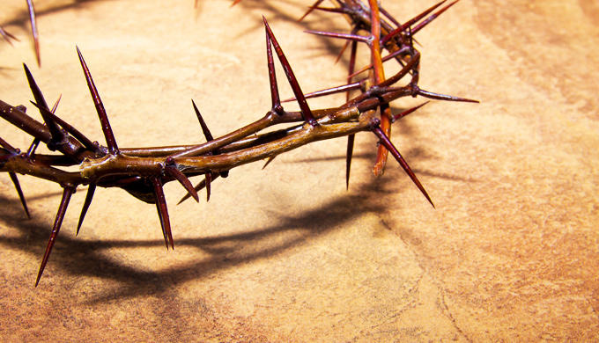
To Know the Fellowship of his Sufferings
Really???
What kind of suffering is this talking about?
Righteous suffering – the kind of suffering we experience by denying ourselves, following Jesus and standing up for his name

Slide 29
To Know the Fellowship of his Sufferings
Western “theology of suffering”:
Bad; to be avoided at all costs
Biblical “theology of suffering”:
Part of God’s plan!

Slide 30
To Know the Fellowship of his Sufferings
Part of God’s plan for Jesus
“It was fitting that God, for whom and through whom everything exists, should make the pioneer of their salvation perfect through what he suffered.”
Hebrews 2:10

Slide 31
To Know the Fellowship of his Sufferings
[Jesus] made himself nothing
by taking the very nature of a servant,
being made in human likeness.
And being found in appearance as a man,
he humbled himself
by becoming obedient to death—
even death on a cross!
Philippians 2:7-8

Slide 32
To Know the Fellowship of his Sufferings
Part of God’s Plan for Us:
Then he said to them all: “Whoever wants to be my disciple must deny themselves and take up their cross daily and follow me.”
Luke 9:23

Slide 33
To Know the Fellowship of his Sufferings
Principles of Suffering from 1 Peter:
2:21 – To this you were called, because Christ suffered for you, leaving you an example, that you should follow in his steps.
1. Christ set the example of suffering for us

Slide 34
To Know the Fellowship of his Sufferings
Principles of Suffering from 1 Peter:
4:12 – Dear friends, do not be surprised at the fiery ordeal that has come on you to test you, as though something strange were happening to you.
2. Suffering is to be expected

Slide 35
To Know the Fellowship of his Sufferings
Principles of Suffering from 1 Peter:
4:13 – But rejoice inasmuch as you participate in the sufferings of Christ, so that you may be overjoyed when his glory is revealed.
3. Suffering with Jesus is a reason to rejoice!

Slide 36
To Know the Fellowship of his Sufferings
Principles of Suffering from 1 Peter:
4:16 – If you suffer as a Christian, do not be ashamed, but praise God that you bear that name.
4. Suffering for Christ is a reason to praise God!

Slide 37
To Know the Fellowship of his Sufferings
Principles of Suffering:
Part of God’s plan for us
Christ set the example of suffering for us
Suffering is to be expected
Suffering with Jesus is a reason to rejoice!
Suffering for Christ is a reason to praise God!

Slide 38
To Know the Fellowship of his Sufferings
How do we participate in his sufferings?
We participate in his sufferings by actively and consistently choosing to obey God – regardless of the cost.
“And he died for all, that those who live should no longer live for themselves but for him who died for them and was raised again.” 2 Corinthians 5:15

Slide 39
To Know the Fellowship of his Sufferings
Examples:
Willingly enduring persecution for our faith
Dying for our faith
Giving a cup of water in the name of Jesus
Choosing to love without being loved back
Serving without recognition
Giving to our own hurt

Slide 40
To Know the Fellowship of his Sufferings
Examples:
Choosing to forgive
Choosing to love our enemies
Putting Christ before marriage
Putting Christ before career
Caring for the elderly / sick / dying
Identifying with Christ when it’s unpopular

Slide 41
To Know the Fellowship of his Sufferings
Why did Paul include the fellowship of his sufferings in knowing Christ?
We cannot fully know Christ without participating with him in his sufferings!
Example: Relating to a parent who has lost a child
Notes:
Example: Let’s say you have a friend who has lost a child. You can be with them and try to comfort them, but you will never really know what they are going through unless you too have experienced it.

Slide 42
To Know the Fellowship of his Sufferings
How do we participate in his sufferings?
We participate in his sufferings by actively and consistently choosing to obey God – regardless of the cost.
Is there an area in your life where you are avoiding obedience due to the cost? Loving? Forgiving? Serving? Giving? Speaking up?

Slide 43
The Surpassing Greatness of Knowing Christ Jesus my Lord…
The nature of this knowledge
The path to this knowledge
The fruit of this knowledge
Notes:
It is in knowing Jesus that we can know God!

Slide 44
The Fruit of this Knowledge
¹⁰ that I may know him and the power of his resurrection, and may share his sufferings, becoming like him in his death, ¹¹ that by any means possible I may attain the resurrection from the dead.
Philippians 3:10-11
Knowing Christ…Suffering…Resurrection…
What’s the Connection?

Slide 45
The Fruit of this Knowledge
Biblical Principle:
The fruit of our current suffering
is eternal glory!
Suffering → Glory

Slide 46
The Fruit of this Knowledge
The fruit of Jesus’ suffering:
Did not the Messiah have to suffer these things and then enter his glory? Luke 24:26
When did Christ receive the reward for suffering?
“… God exalted him to the highest place and gave him the name that is above every name…” Ph 2:9
Suffered → Died → Resurrection → Glory!

Slide 47
The Fruit of this Knowledge
The fruit of our suffering:
For our light and momentary troubles are achieving for us an eternal glory that far outweighs them all. 2 Corinthians 4:17

Slide 48
The Fruit of this Knowledge
The fruit of our suffering:
¹⁶ The Spirit himself testifies with our spirit that we are God’s children. ¹⁷ Now if we are children, then we are heirs—heirs of God and co-heirs with Christ, if indeed we share in his sufferings in order that we may also share in his glory. Romans 8:16-17

Slide 49
The Fruit of this Knowledge
The fruit of our suffering:
But rejoice inasmuch as you participate in the sufferings of Christ, so that you may be overjoyed when his glory is revealed.
1 Peter 4:13
When will we receive the reward for suffering?
Suffer → (Die?) → Resurrection → Glory!

Slide 50
The Fruit of this Knowledge
It is only in light of eternity that knowing Christ in his sufferings makes sense!
Sharing in his sufferings → Sharing in his glory!

Slide 51
What about you?
Do you know about God?
Or do you know him personally through Jesus?
You can know him if you are willing to:
Believe in him – accept his righteousness on your behalf

Slide 52
If you know him personally…
On a scale of 1-5, to what extent can you agree with Paul’s statement:
“I consider everything a loss compared to the surpassing greatness of knowing Christ Jesus my Lord.”

Slide 53
How do we Grow in Knowing Him?
Allow his power to transform your life
Trust in his power to enable your ministry
Embrace his plan of obedience, suffering and future glory

Slide 55
NT Preaching link at BibleStudyDownloads.org
Get this presentation for free!
Notes:
NT Preaching (np)

